Slide 1
Final Presentation
Parking Lot Vehicle Classification
Team Members: Aniruddha Srinivasan, Coleman Todd, Fabianna Barbarino, Jacqueline Mioduski, Spencer Cho, Tyler Roosth

Slide 2
Problem Background
Increased vehicle traffic as business growth occurs
Security personnel need to identify a large number of cars simultaneously
Analysts need to track heavier traffic flow
Notes:
Parking lots are a source of frustration for many people. They tend to be the site of many crashes and illegal parking. ?
As businesses grow their customer base, the parking lot around their locations will be subject to more traffic (both vehicle and pedestrian), this results in both security and analyst personnel having to process more data with the same amount of time. For security, they must be able to identify the status of a large amount of cars. For analysts, they must track and map all customer behavior.

Slide 3
Goals & Objectives
Vehicle detector can track at least 5 cars
Bounding Boxes around the cars
Tie the back-end with the front-end successfully
Implementation works as a desktop app on a GPU workstation/laptop
Our main goal was to build a containerized app that detects and tracks vehicles across a parking lot and continually logs the driving patterns.
Our 3 states are: parked, moving, and stopped
Monitored through the user interface by security personnel or data scientist.
The coordinates will be sent to our database.
This has been successfully completed!
Cameras will be 12 feet off the ground looking out. This has been successfully completed!
GUI should show data associated with the video playing. This has been successfully completed!
Notes:
Mention the change in scope (no live video feed -- sticking to mp4 pre-recorded videos)

Slide 4
Evaluation of Alternative Solutions
Detection Algorithms
Tracking Algorithms
YOLOv8
Mask R-CNN
DeepSORT
ByteTrack
SMILETrack
Fastest
Most accurate for object detection
Slower
Most accurate for object area
An established method
Poor FPS
Higher FPS than DeepSORT
Better supporting documentation/tutorials
Cutting edge- Ranked the highest for HOTA, MOTA, & IDF1

Slide 5
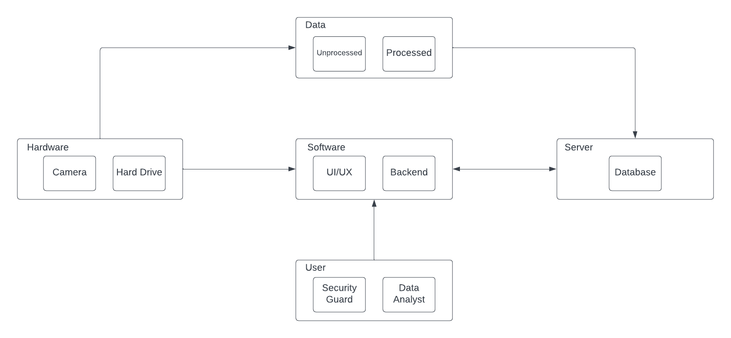
System Level Description
Notes:
5 building blocks of the project defined
Software, Hardware, Server, User, and Data
Software: A UI/UX created in React.js and a backend using Python’s machine learning modules. Containerized using Docker to allow for easy testing, deployment, and version control.
Hardware: Camera that captures video footage of parking lot, hard drive used to store our application and data for deployment on other machines
Data: Unprocessed and processed data
Server: Database which stores both data types and keeps track of training
User: Security guard who would use the application to view for any illegal activity, Data Analyst that would use the application to view potential traffic jams

Slide 6
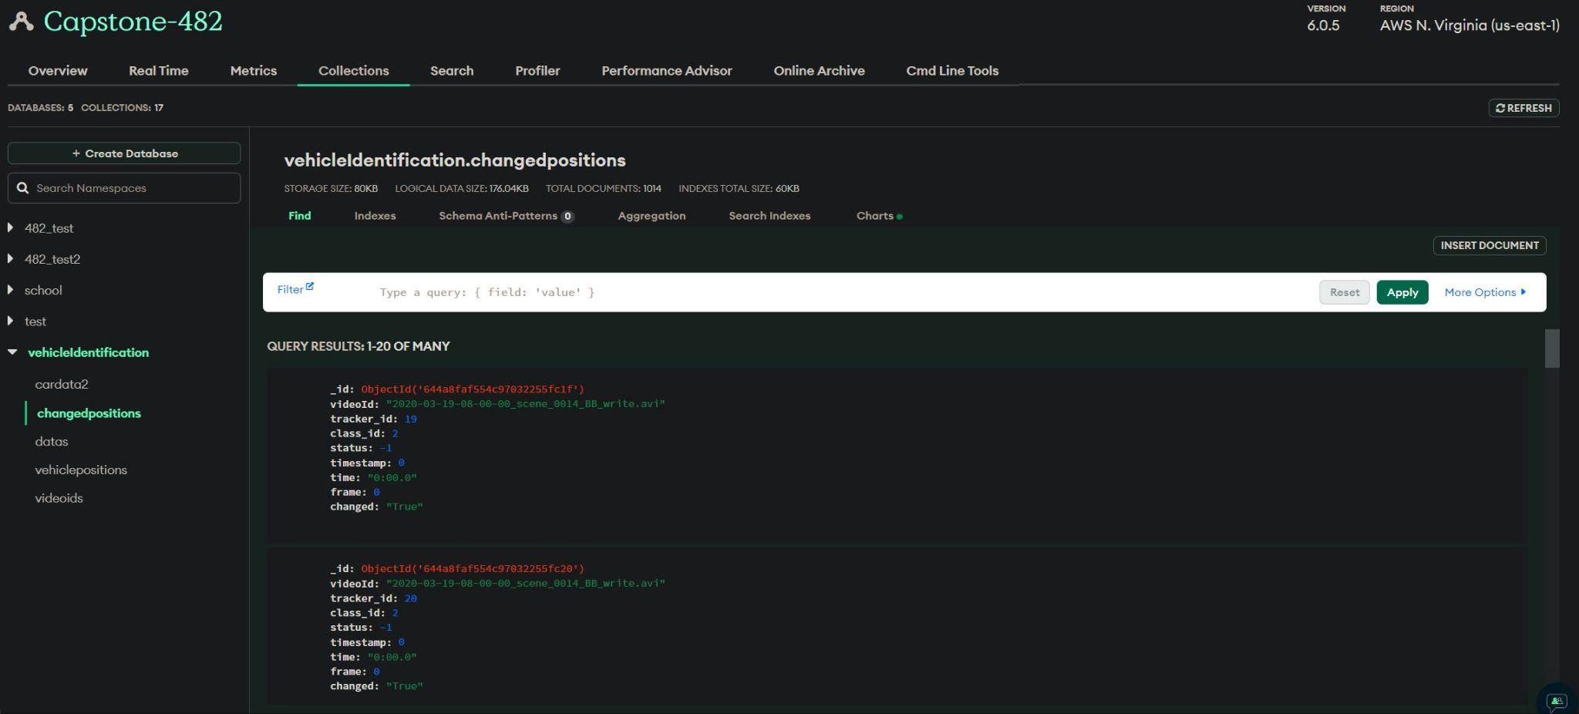
Database
MongoDB Database
Information is stored into MongoDB Atlas
stored from ML side
Connects using FastifyAPI and Fetched on Front End
Contains information about the vehicles and videos
videoId
time
changed
status
tracker_id
And more
Notes:
Tyler

Slide 7
Approach for Design Validation
ML Detection
Backend
GUI
Infrastructure
Main Goal: Full Stack Operation
Web Application able to view annotated video feed, clickable timestamp, 2 separate views, and view details of parked,stopped, moving vehicles.
Business analyst view updates with data from MongoDB database. Has historical data in table that can be filtered by state
Application and ML run in separate Docker containers smoothly with reasonable usage of resources
5 cars 10 FPS
Vehicle status
Optimized scenario
37 cars 11.77 FPS
MongoDB Database
Record position, time, status,id, etc
2 separate views
Filter by status
Show relevant information
Runs in Docker container
1GB VRAM Linux
Notes:
Ideally 1 USB camera can send a live feed to our application. But we’ve established that it doesen’t have to be live, and that the annotated video can be premade
Web application should be able to view this, and view details of parked, stopped, not stopped
Business analyst view should update with data from MongoDb database

Slide 8

DEMO
Link to Video

Slide 9
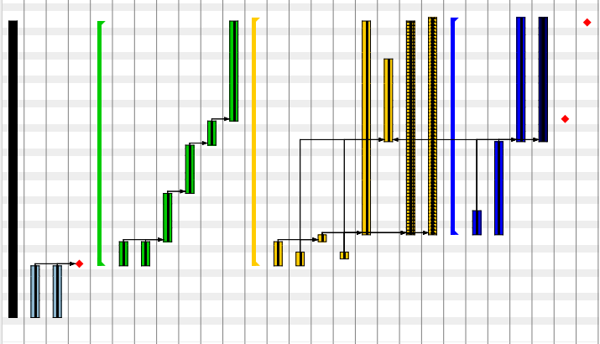
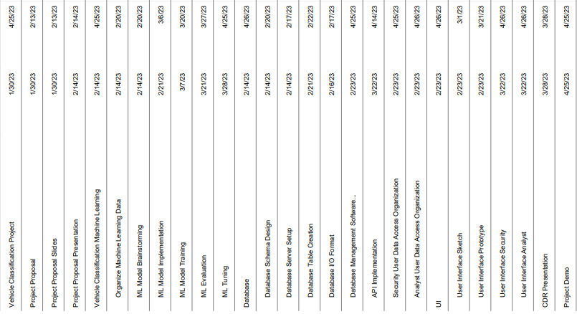
Timeline

Slide 10
Project Management and Teamwork
ML Recognition
User Interface
Database Server Management
Docker & Documentation
Members divide into 3 pairs
Tasked with module connections
Assignments are flexible
2 in-person meetings weekly
Aniruddha Srinivasan & Jacqueline Mioduski
Tyler Roosth & Coleman Todd
Fabianna Barbarino & Spencer Cho
All Member & Rotating

Slide 11
Societal, Safety, and Environmental Analysis
Beneficial Impact
Detrimental Impact
Potential loss of privacy due to information being stored and cameras recording
Ethical concern
Increase in parking lot safety is a benefit to society
Safety Precautions we must take
Environmental Impact
Inclement weather may damage camera
Carbon emissions from streaming video footage, but these cameras have to be on.

Slide 12
Manufacturability, Sustainability, and Economics
Economics
Sustainability
creates a flexible, repeatable, efficient, & cost-effective process to assist parking lot monitoring
analytics may be used to reduce parking lot traffic density = lower carbon footprint
Manufacturability
will use existing architecture to gather, process, & store data

Slide 13
RESOURCES
[1] “Parking lots & distracted driving,” National Safety Council. [Online]. Available: https://www.nsc.org/road/safety-topics/distracted-driving/parking-lot-safety. [Accessed: 02-Feb-2023].
[2] “Wireless M-Gage Node,” Banner Engineering. [Online]. Available: https://www.bannerengineering.com/us/en/products/wireless-sensor-networks/wireless-sensors/wireless-m-gage-node.html?sort=1#all. [Accessed: 12-Feb-2023].
[3] “Monitoring software,” Parksol, 26-Aug-2022. [Online]. Available: https://parksol.lt/solutions/monitoring-software//. [Accessed: 12-Feb-2023].
[4] Z. Yin, H. Xiong, X. Zhou, D. W. Goldberg, D. Bennett, and C. Zhang, “A deep learning based illegal parking detection platform,” Proceedings of the 3rd ACM SIGSPATIAL International Workshop on AI for Geographic Knowledge Discovery, 2019.
[5] A Deep Learning Based Illegal Parking Detection Platform. YouTube, 2019.
[6] S. parking, “Smartpark system,” Smart parking, 07-Apr-2022. [Online]. Available: https://www.smartparking.com/smartpark-system. [Accessed: 12-Feb-2023].

Slide 14
RESOURCES cont.
[7] R. Stiawan, A. Kusumadjati, N. S. Aminah, M. Djamal, and S. Viridi, “An ultrasonic sensor system for vehicle detection application,” Journal of Physics: Conference Series, vol. 1204, p. 012017, 2019.
[8] “Papers with code - mot17 benchmark (multi-object tracking),” The latest in Machine
Learning. [Online]. Available: https://paperswithcode.com/sota/multi-object-tracking-on-mot17. [Accessed: 13-Feb-2023].
[9] Emergen Research, “Security cameras market size, share: Industry forecast by 2030,” Security Cameras Market Size, Share | Industry Forecast by 2030. [Online]. Available: https://www.emergenresearch.com/industry-report/security-cameras-market#:~:text=Market%20Synopsis,18.7%25%20during%20the%20forecast%20period. [Accessed: 11-Feb-2023].
[10] D. Hardawar, “FCC Bans Telecom and video surveillance gear from Huawei, ZTE and other Chinese companies,” Engadget, 25-Nov-2022. [Online]. Available: https://www.engadget.com/fcc-officially-bans-telecom-and-video-surveillance-gear-from-several-chinese-companies-003040729.html. [Accessed: 11-Feb-2023].
[11] P. N. Service, “Turn off that camera during virtual meetings, environmental study says,” Purdue University News. [Online]. Available: https://www.purdue.edu/newsroom/releases/2021/Q1/turn-off-that-camera-during-virtual-meetings,-environmental-study-say

Slide 15
THANK YOU!
Do you have any questions?

